Slide 1

Libra Summer School and Workshop 2024
Alexey Akimov, Sophya Garashchuk, Mohammad Shakiba, Daeho Han, Qingxin Zhang
University at Buffalo, SUNY
July 8, 2024

Slide 2
Libra Summer School/Workshop
Goals and Objectives

Slide 3
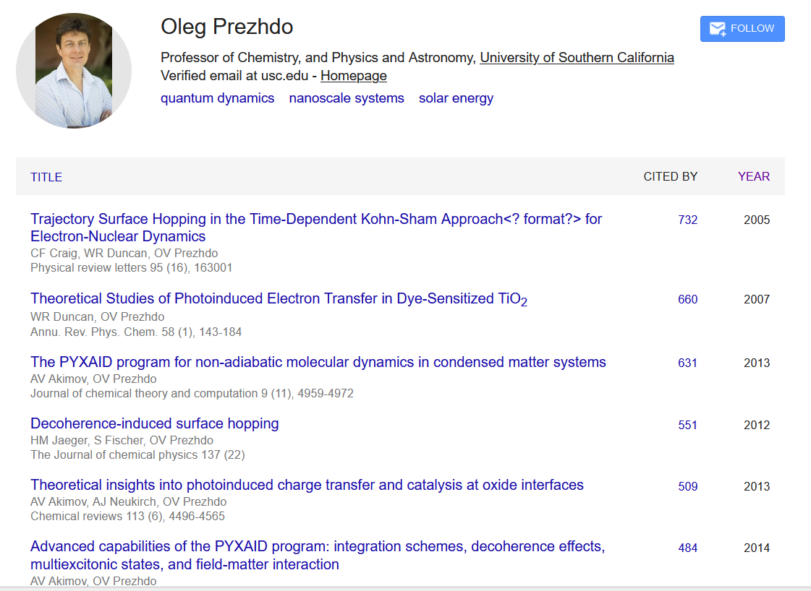
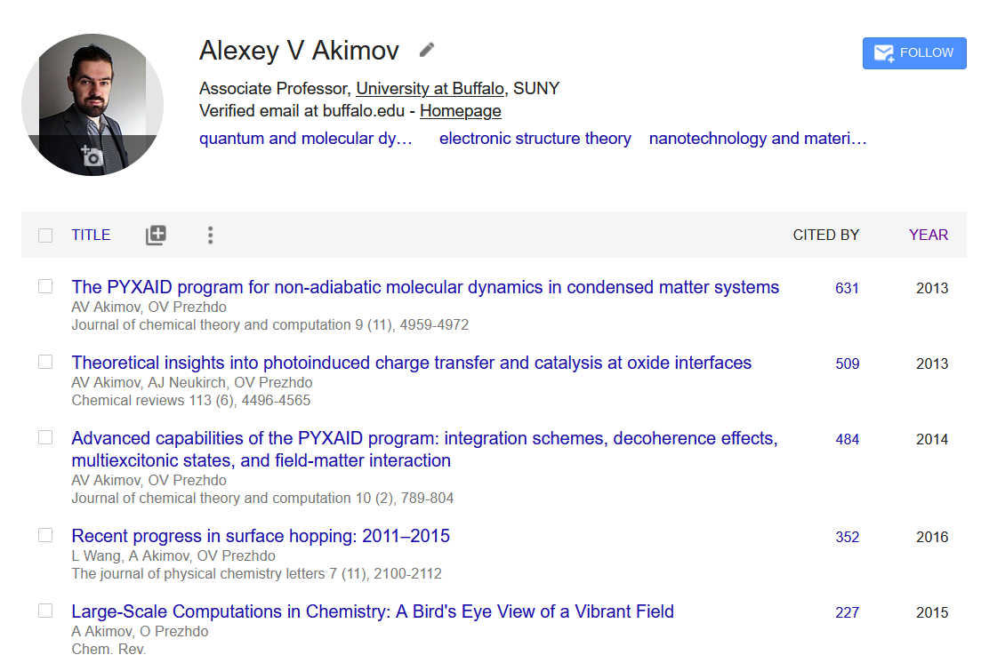
Scientific Software Availability is essential
Challenges:
too many scripts, the connections are unclear (long training time)
Fortran (quite “bulky”), Perl for workflow (intimidating to understand), poor modularity – difficult to add new methods
Interfaced only with VASP
Internal, not available to the public
No structured tutorials
Changes:
more clear workflow organization
C++ and Python, more modular and user-friendly interface. As a result: added new methods (decoherence)
Interfaced with QE, but not only
Publicly available, open-source
Dedicated tutorials
Oleg’s 2-nd most cited paper (excluding 2 reviews)
Oleg’s 1-st most cited paper (excluding 2 review)
My 1-st most cited paper (excluding 1 review)

Slide 4

Still not sufficient: Libra motivation
Many codes (Newton-X, SHARC, NEXMD, FIERBALL, JADE, MOLPRO, PYXAID, PYUNIXMD, …)
Black-box. Difficult to re-use to formulate other methods, etc.
Limited functionality (high focus, e.g. atomistic of special kind)
Many methods (FSSH, DISH, A-FSSH, QTAG, QTSH, etc.)
Not always available
Not always user-friendly (e.g. my experience with PYXAID prototype)
Not always portable/modular, lack of best coding standards, no version control, etc.
Limited consistency of different codes
Possible redundancies even in the same code
Libra’s approach
Versatility: encompass a comprehensive set of available methodologies
Community-centric: be the platform for various methods developed by the community
Modularity: easy-to-use methodology building blocks, methodology development
User-friendliness & Open-source: easy experience, without limitations
Libra
https://github.com/Quantum-Dynamics-Hub/libra-code

Slide 5
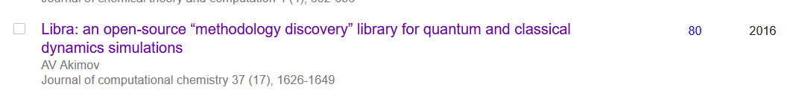
Libra motivation
The key “software” papers
Adopt the best practices
Modularity (e.g. PySCF, Psi4NumPy, PyQuante, HORTON)
Language standards (Python, C++ vs. Fortran? Hybrid programming)
Testing & Documentations (pytest, unittest, Doxygen/Sphinx)
User/developer training (Workshops, Summer/Winter schools)
Focus on the community
Every group has expertise in their field – rely on that
Community contributions – PR on GitHub
Use version control and collaborative workflows via GitHub, Issues
Frequent communication and close collaboration e.g. via Slack
Many changes compared to Pyxaid – a lot of correctness issues fixed, more reliable approach
Nearly all the projects in my lab use it
There is a growing number of users who use it – that’s another reason to host this event

Slide 6
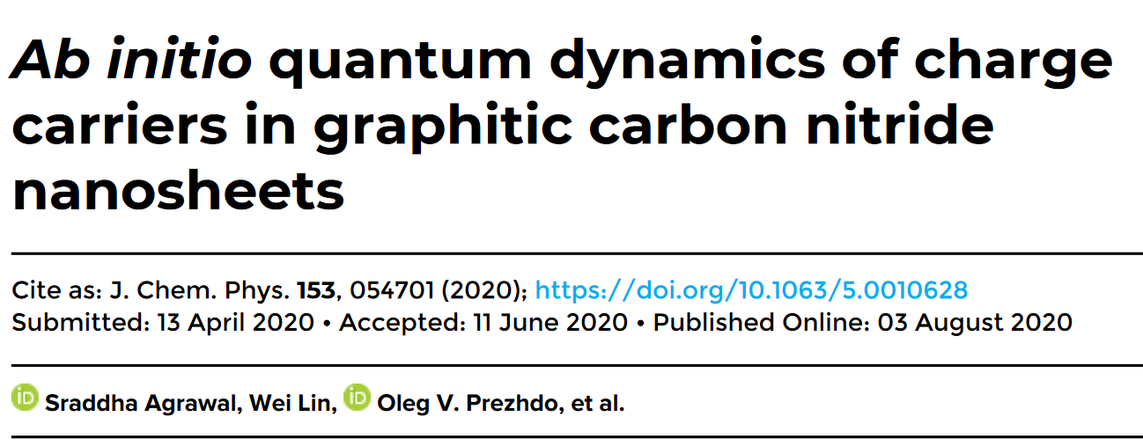
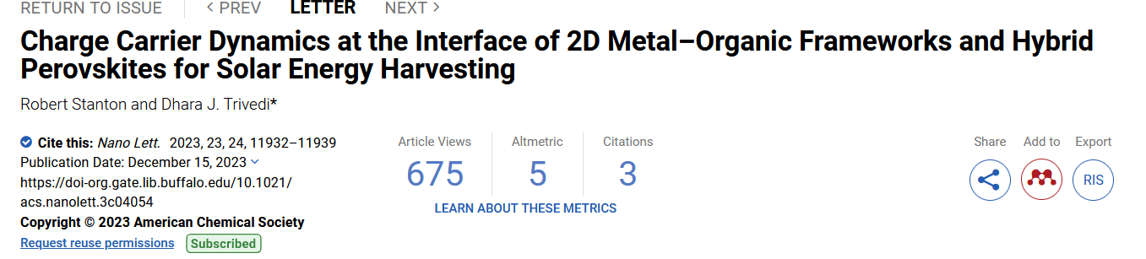
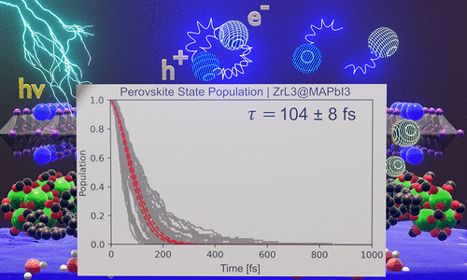
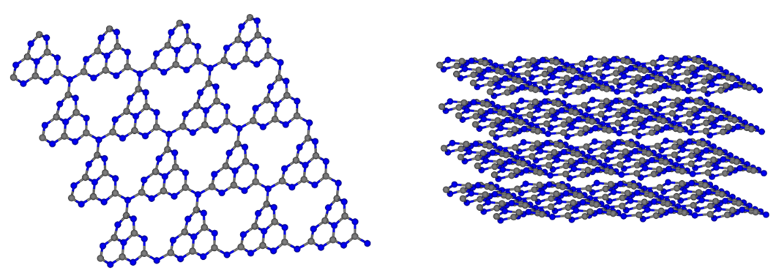
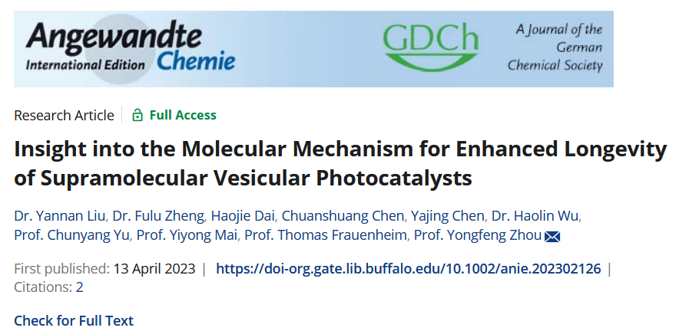
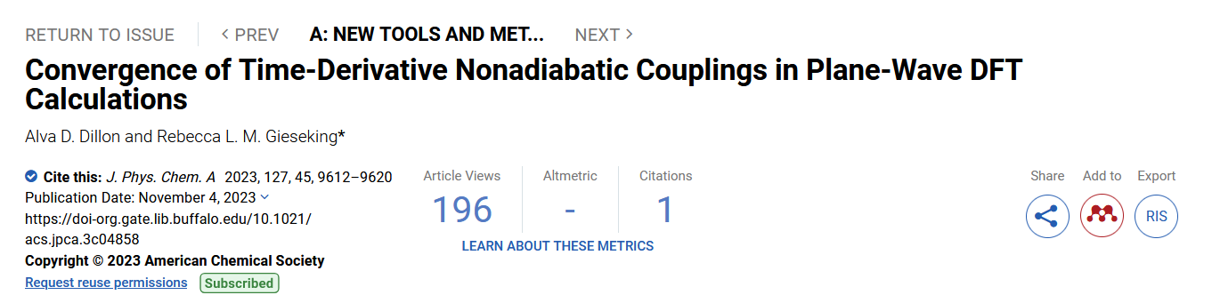
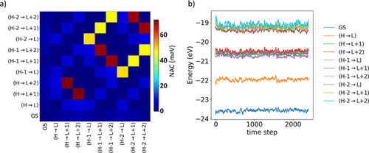
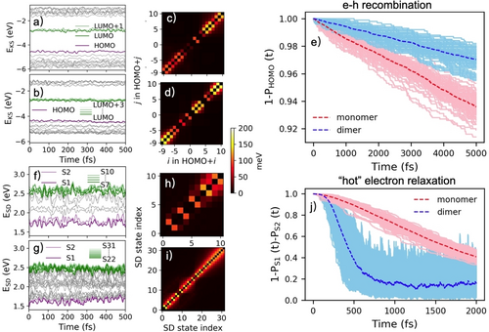
Some papers that use Libra
+ many works in my group
+ upcoming works

Slide 7

Objectives of this Workshop/Summer School
“Elements: Libra: The Modular Software for Nonadiabatic and Quantum Dynamics”
Develop new functionality in the Libra code
Train users/developers & facilitate the adoption by the community (this workshop)
Visitations for the collaborators
Objectives:
Learn what is available, the best practices, known pitfalls
Learn to conduct atomistic and model calculations (theory and practice)
Learn internals, so that you could potentially contribute
Overarching goal: become the code’s user and/or developer

Slide 8
Why to contribute?
Make your methods broadly available (mutually advertise)
Be listed on the developers/contributors lists, get credentials, get citations
Make your methods compatible with other methods, enable easier interfacing – this facilitates new methods developments
Take advantage of other methods/functions/data types available in the same code – learn once then swim
Take advantage of improvements of other parts of the code
Mutually ensure the best standards and facilitate bug discovery/testing

Slide 9
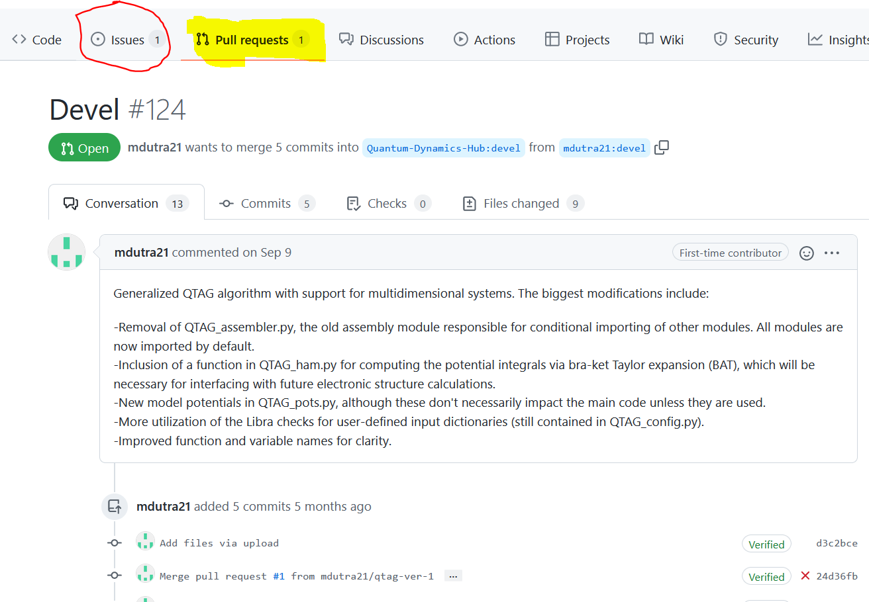
How to contribute?
https://github.com/amber-jain-group-iitb/heom_amber
Before:
hard-coded inputs (recompile for all parameters)
Fortran into executable
After:
General-purpose code, any inputs
Python/C++, integrate with the plotting scripts, etc.
create a pull-request
open an issue
start a discussion (haven’t tried yet)

Slide 10
Libra Summer School/Workshop
Logistics & Agenda

Slide 11
Getting to Know Each Other

Slide 12
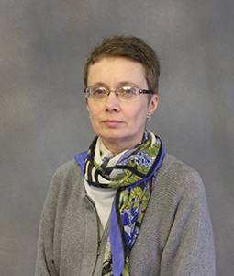
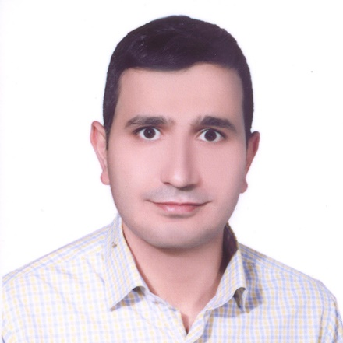
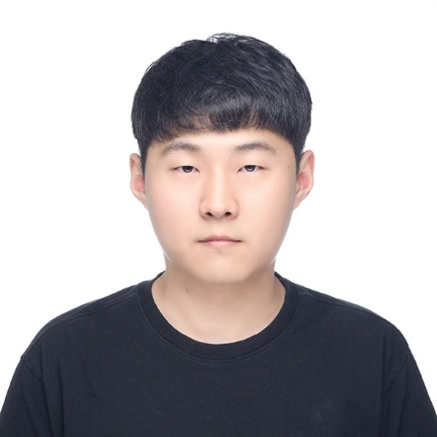
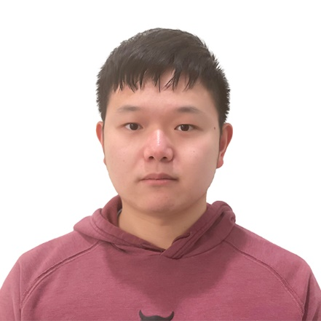
Instructors and Co-Instructors
Alexey Akimov
TSH, SOFT, HEOM
Mohammad Shakiba
Atomistic NBRA-NA-MD,
ML, CP2K
Daeho Han
XF
Sophya Garashchuk
QTAG
Please Introduce Yourself
Name, position, affiliation, research group
Research interests and expertise
Anything else you would like to share with us
Qingxin Zhang
Atomistic NBRA-NA-MD, CP2K

Slide 13
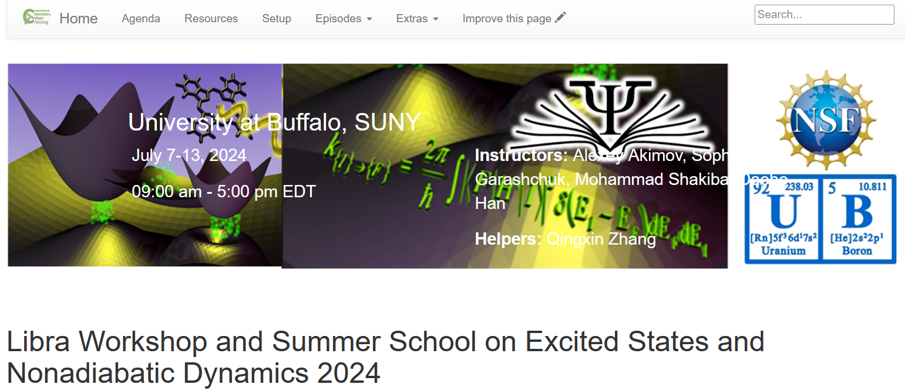
The Plan & Resources
All the details are here:
https://compchem-cybertraining.github.io/Libra_Summer_School_2024/
Join Slack:
https://join.slack.com/t/quantumdynamicshub/shared_invite/zt-mjbhjssx-GGhsbYHxeBMvhmumK_j7LA
Members can invite new members
Private and public channels, direct (private) messages, conversations
Any time, but no strings attached
VPN and Accounts:
setup now, instruction by Ms. Dori Sajdak
2-factor authentication
submit a ticket: https://ubccr.freshdesk.com/support/home

Slide 14
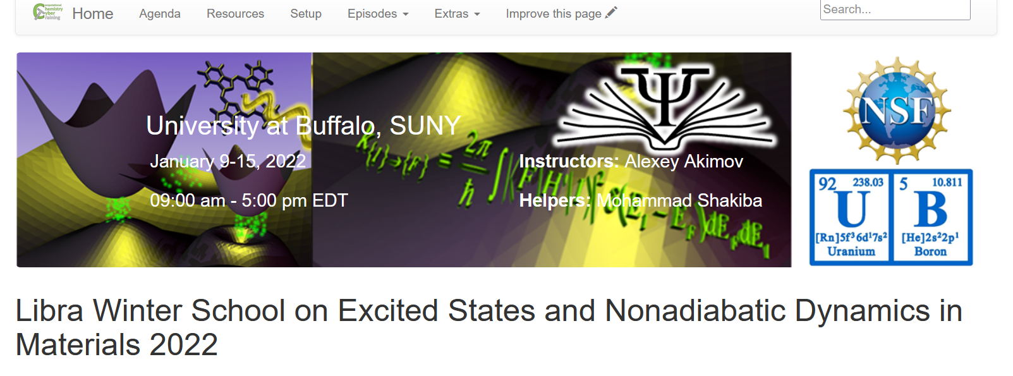
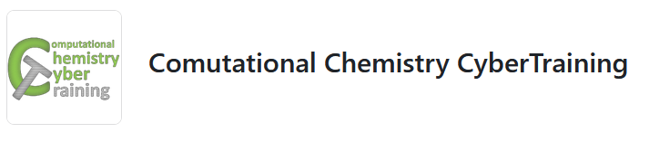
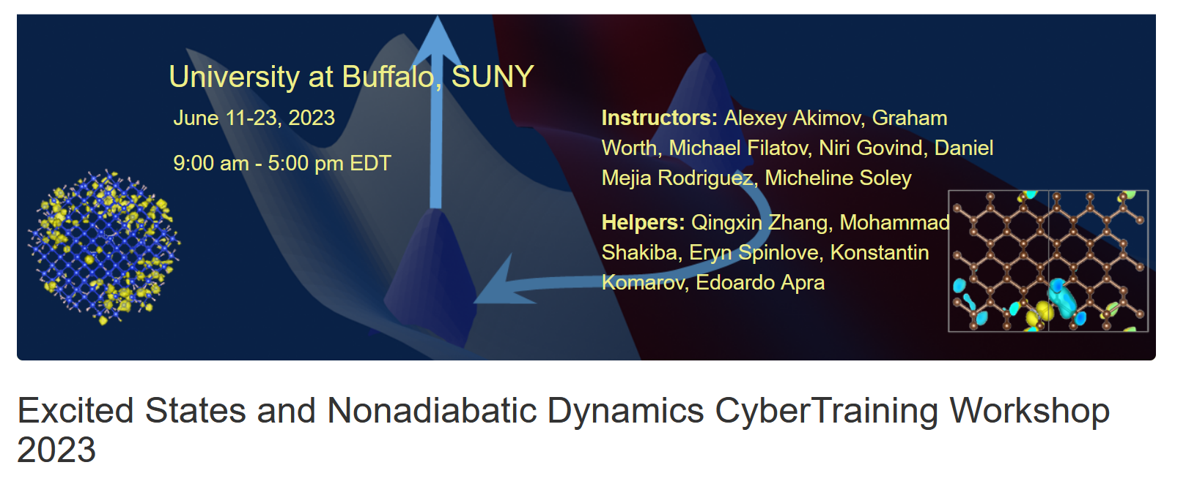
Resources: Past Events
This is the second event on Libra:
The first one – Winter 2022:
https://compchem-cybertraining.github.io/Libra_Winter_School_2022/
https://github.com/compchem-cybertraining
Learning Libra: The dedicated set of tutorials: https://github.com/compchem-cybertraining/Tutorials_Libra
Learning Libra AND theory AND other packages: CyberTraining workshops
2023: https://compchem-cybertraining.github.io/Cyber_Training_Workshop_2023/
https://github.com/compchem-cybertraining/Cyber_Training_Workshop2023_course_projects
2022: https://compchem-cybertraining.github.io/Cyber_Training_Workshop_2022/
2021: https://compchem-cybertraining.github.io/Cyber_Training_Workshop_2021/

Slide 15
Event Plan
https://compchem-cybertraining.github.io/Libra_Summer_School_2024/schedule.html
Monday: Introduction, Libra overview, Presentations
Tuesday: Model Hamiltonian setups, Quantum, TSH/Ehrenfest, and HEOM calculations for model problems.
Wednesday: QTAG, VISTA, Exact factorization (XF)
Thursday: TSH calculations for atomistic systems
Friday: Machine learning for atomistic systems
Notes:
1. The focus is to apply these skills to your own systems, not just to follow the tutorials
Some tasks are interconnected – you will use the results of your calculations in later stages
Plenty time for discussion and collaboration on every day: Not just the tutorials

Slide 16
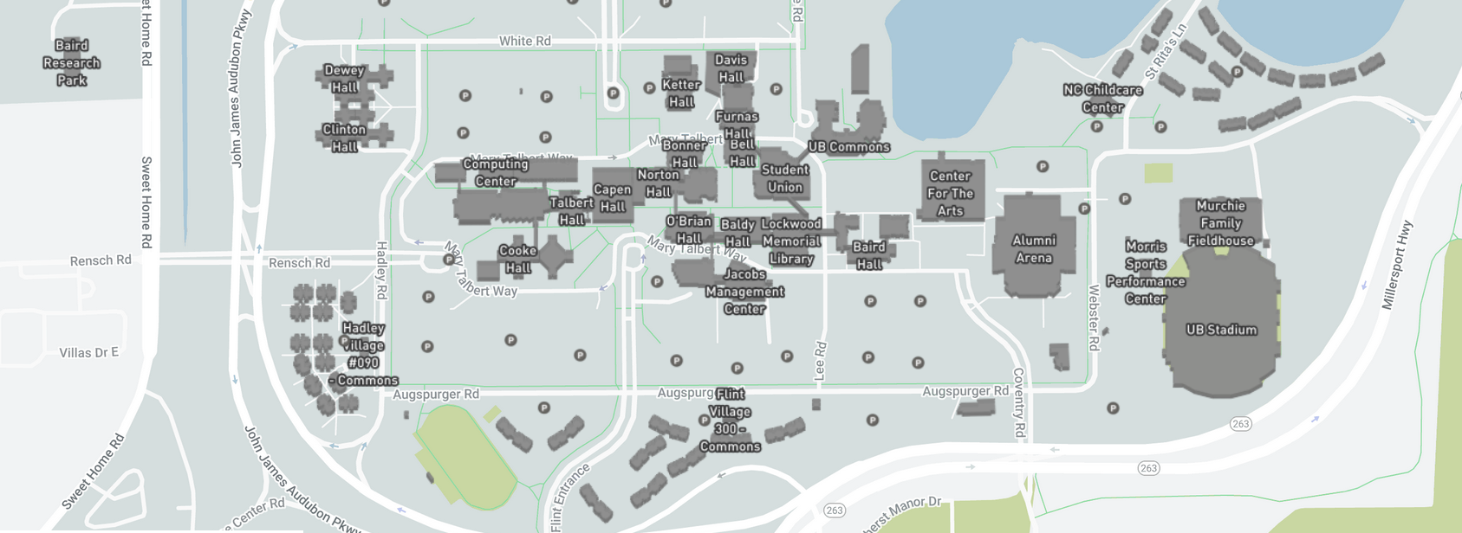
Daily Schedule
Daily
Breakfast = hotel
9:00 am – 12:00 pm: Morning session (Recording)
12:00 – 1:30 pm Working lunch/rest – on your own at “Commons”, rest, discuss, collaborate
1:30 pm – 5:00 pm: Afternoon session (Recording)
After 5:00 pm: collaborations/on your own, dinner on your own
Eat here
Location
Classes are @: July 8, 9 – Clemens 120
July 10, 11 – NSC 220
July 12 – Baldy Hall 200G
Your hotel plaza
Campus Map: https://www.buffalo.edu/home/visiting-ub/map.html

Slide 17
Post-workshop – Reimbursement & Accounts
We cover your hotel stay (except for the local folks). Stipends also cover the rest of expenses, please keep your receipts just in case. Let me know your flight/car expenses via Slack (DM)
Travel for the US participants to a reasonable amount, partially the international participants (as the funds allow), except for local/UB-affiliated folks.
Paperwork: All trainees will need to fill in the RF Participation Stipend form and one of the other two forms: W-9 - for the US residents and W-8BEN for the non-residents. The forms are distributed to you via Slack – please DON’t sent them back via e-mail – upload to the form provided or via Slack.
A lot of paperwork later – likely it’ll be just me handling most of the stuff
Reimbursement/honoraria to the instructors (non UB-affiliated) – a separate paperwork. Will send you instructions via the Instructors Channel on Slack.
You UB CCR accounts will be valid until end of August – feel free to use them as needed (but don’t forget to acknowledge it if it results in a publication).

Slide 18
Getting Started on UB CCR

Slide 19
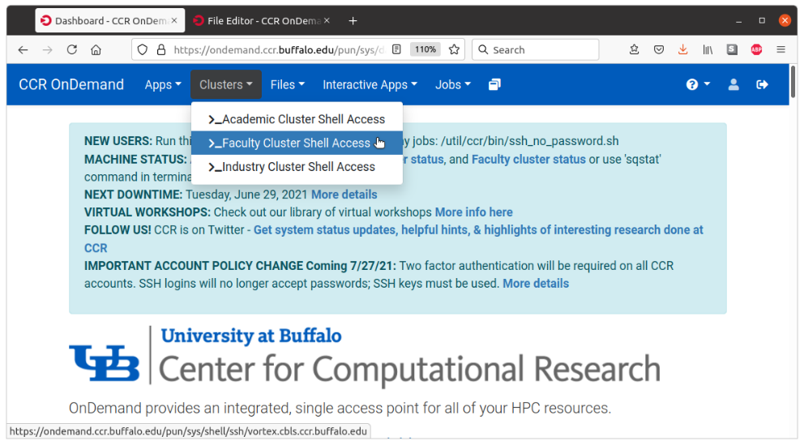
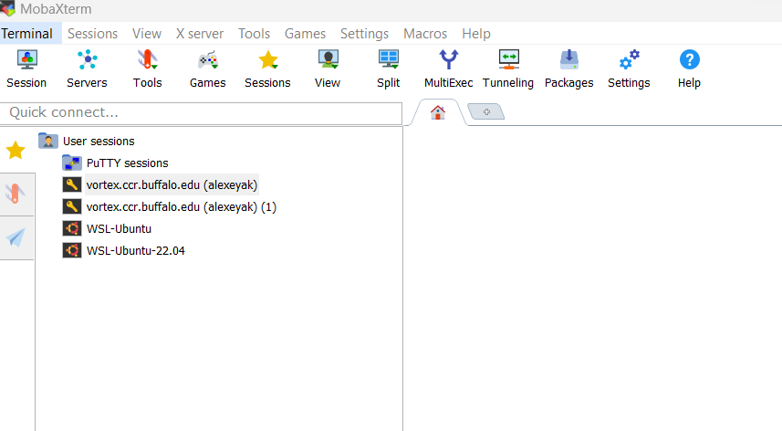
Accessing UB Computing Resources
Before the Workshop
https://compchem-cybertraining.github.io/Libra_Summer_School_2024/setup.html
OnDemand
On campus – nothing special;
Off-campus – use UB VPN
https://ondemand.ccr.buffalo.edu/
Moba Xterm
Generate the SSH public/private key.
Use Moba Tools -> MobaKeyGen
Coordinate it with your UB credentials
https://docs.ccr.buffalo.edu/en/latest/portals/idm/

Slide 20
Accessing UB Computing Resources
Your .bashrc file (in your home directory)
https://akimovlab.github.io/soft_and_tuts/3.4-libra.html
# .bashrc
# User specific aliases and functions
# Source global definitions
if [ -f /etc/bashrc ]; then
. /etc/bashrc
fi
module use /projects/academic/cyberwksp21/MODULES module load libra/devel export PYTHONPATH=/projects/academic/cyberwksp21/SOFTWARE_NEW_ENV/libra/devel/_build/src:$PYTHONPATH export LD_LIBRARY_PATH=/projects/academic/cyberwksp21/SOFTWARE_NEW_ENV/libra/devel/_build/src:$LD_LIBRARY_PATH
Restart terminal or `source .bashrc`
For terminal-based operations: Activate conda environment: `conda activate libra`
For Jupyter – just launch it
Projects directory: /projects/academic/cyberwksp21 - slower, smaller, but permanent
Scratch space: /vscratch/grp-cyberwksp21 - faster, larger, but temporarily (unused files are cleaned up every 1 or 2 weeks)

Slide 21
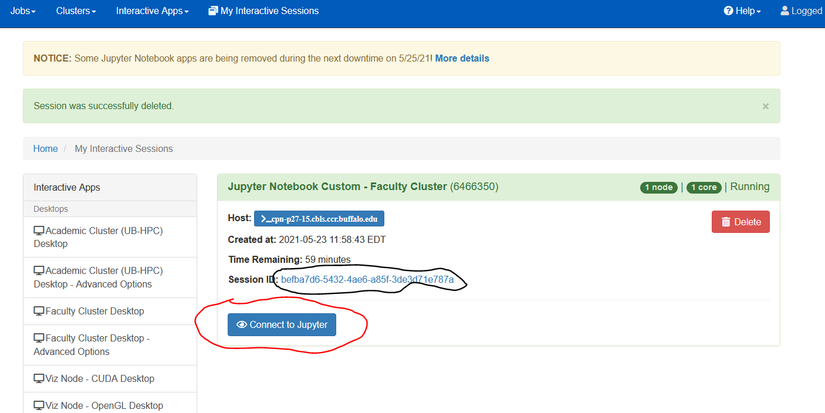
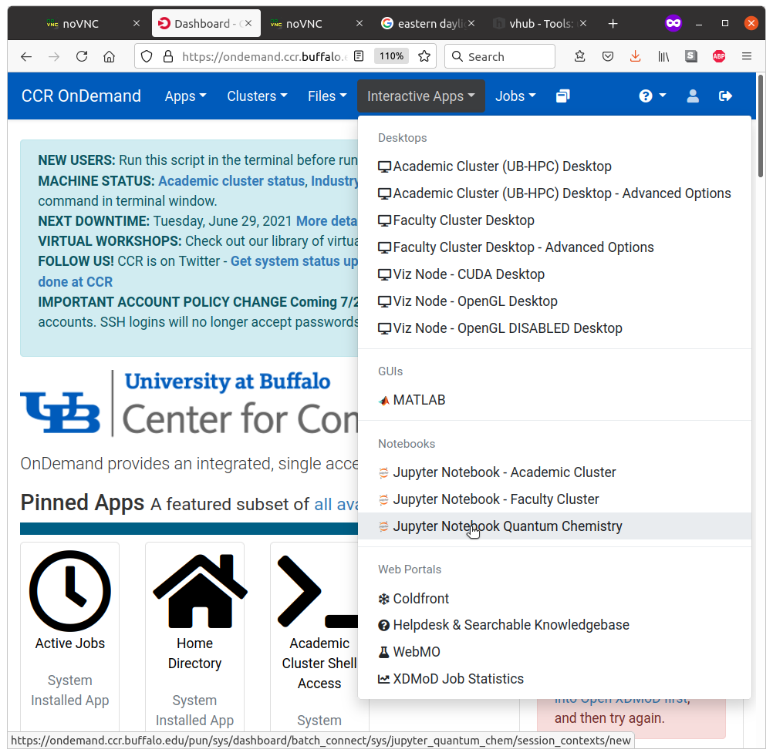
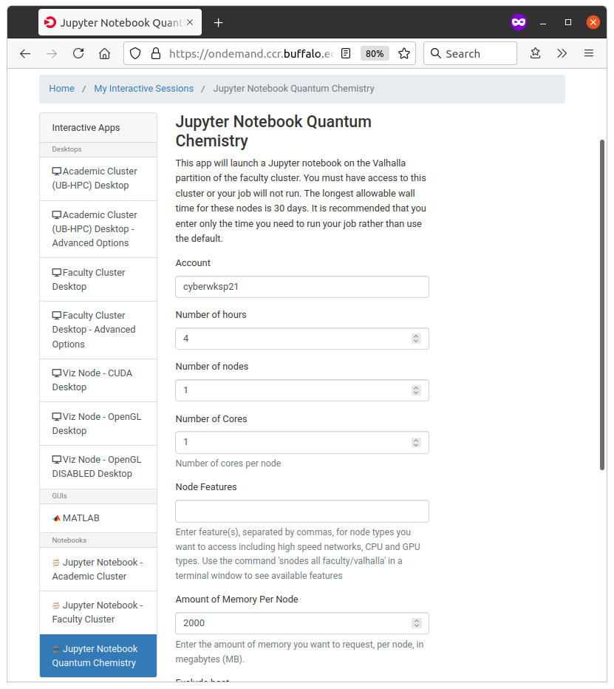
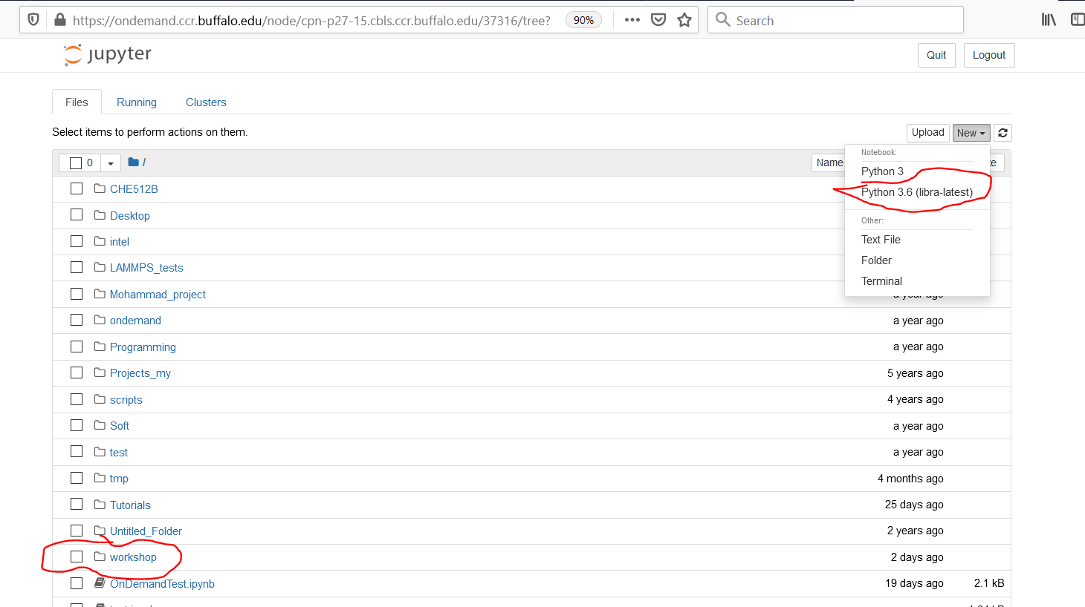
Using Jupyter Notebooks
https://akimovlab.github.io/soft_and_tuts/3.4-libra.html

